Slide 1
Visibility and Communication
A Module in Agile Fundamentals
Notes:
Plan, execute and report on Agile projects
--------------------------------------------------------------------------------------------------------------------
Welcome to the module Planning the Project. This module is brought to you by ThoughtWorks Studios, maker of Mingle, Cruise, and Twist.
In this module, we’ll explore the practices that help Managers and Project Managers plan, execute, and report on Agile projects.

Slide 2
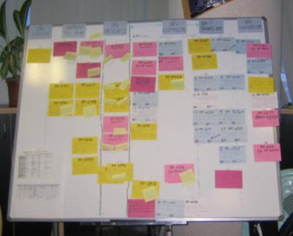
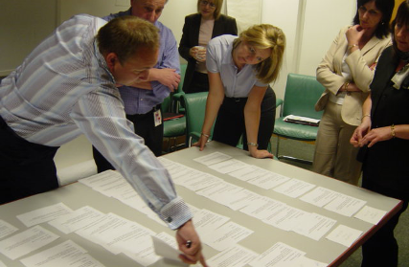

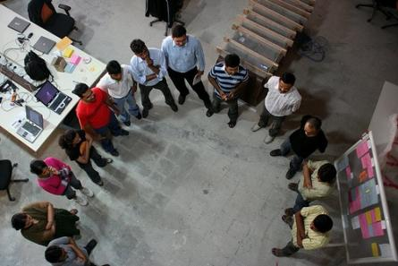
Key Agile Meetings
Iteration Planning
Showcase
Stand Ups
Retrospectives
Notes:
3 of these meetings can be done distributedly.
We discourage distributed Release Planning.
Mountain goat software has distributed Planning Poker.
Ideaboardz and Edistorm are good for distributed Retrospectives.

Slide 3
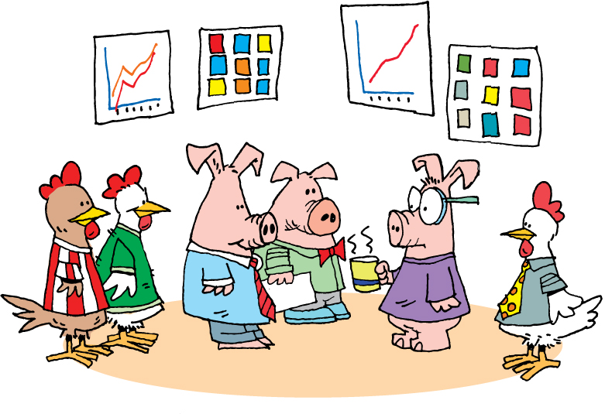
Daily Stand-Up
Notes:
Daily Scrum or daily standup
Chickens and pigs – who talks, who doesn’t
Held daily
Entire team
Answer 3 questions
What did you do yesterday?
What are you going to do today?
What obstacles or impediments are preventing you from making progress?
Short
Conducted by the card wall
Everyone stands
Keeps everyone informed
Not a status meeting
--------------------------------------------------------------------------------------------------------------
Whether you talk about Scrum – and call them daily scrums – or XP – and call them daily stand-ups – the concept is common to both systems. The idea is that the project team gets together daily, stands up, and each committed member of the team (the pigs) shares the answers to these three questions:
What did you do yesterday?
What are you going to do today?
What obstacles or impediments are preventing you from making progress?
Generally speaking, these meetings should be pretty short. Team members will frequently refer to stories by number or title, like “I completed number 421 yesterday and am going to start on number 437 today. I can’t get going until the database is set up.”
Since the card wall - whether physical or electronic - is readily available and visible, generally it’s easy for everyone to understand what is being discussed.
The meetings are held standing, because the goal is to keep them short. Anything that doesn’t fit easily into the answer to one of the questions is recorded and discussed at the end of the stand-up meeting. Chickens are generally not permitted to speak during stand-up, as what they have to say may be important and valuable, but is not a part of this particular meeting.
The daily stand-up, or daily scrum, contributes significantly to keeping all parties informed about what’s going on and what progress is being made.
The daily stand-up is not a status meeting. It is not an opportunity for everyone present to report to the project manager, scrum master, or anyone else. The daily stand-up is a chance for everyone to keep up to date with what is going on on the project.

Slide 4
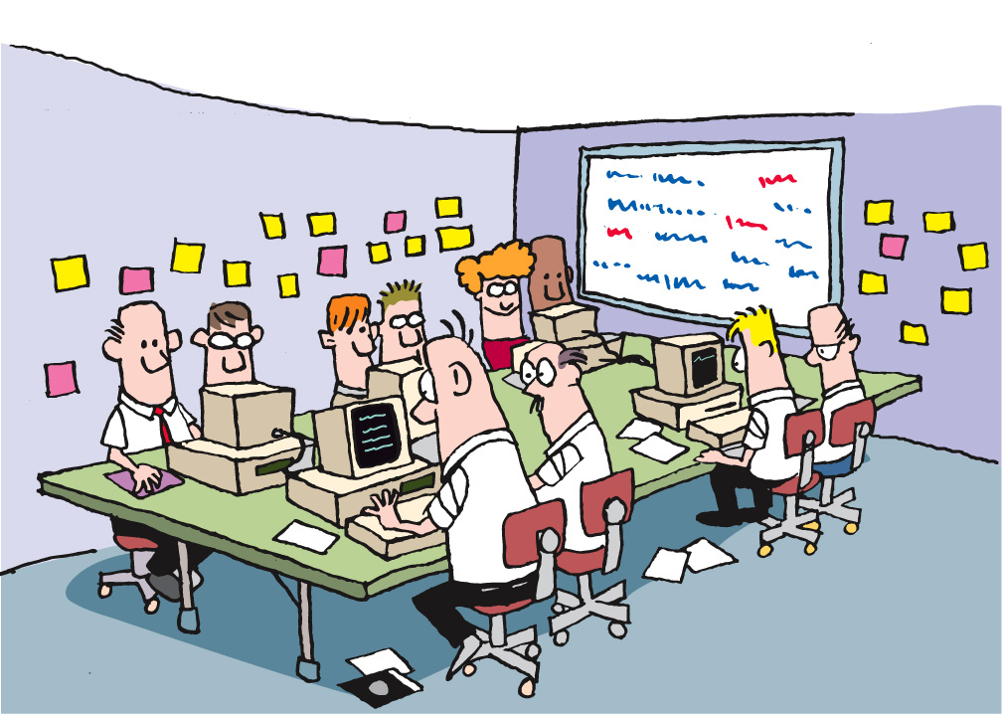
Team Room: Open Conversations
Notes:
If you are a small team, working in a team room, and pairing, you may not need daily stand-ups, but this is a very rare occurrence

Slide 5
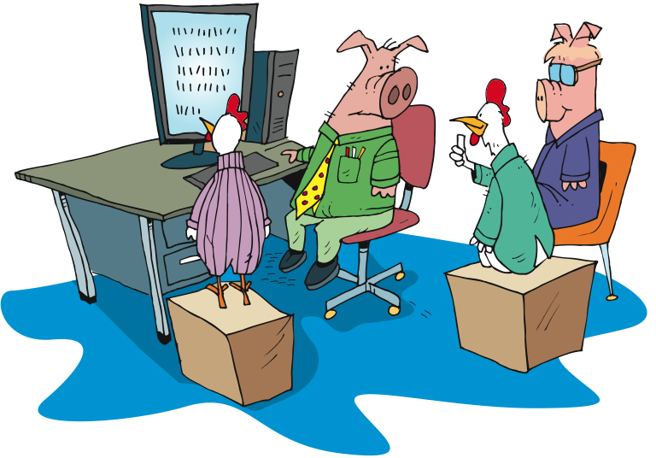
Showcases
Notes:
Goal - Working software at the end of each iteration
Showcase at the end of each iteration
Not design session or brainstorming
We do get feedback
Feedback may turn into new stories
For the chickens
-------------------------------------------------------------------------------------------------
With the goal of ensuring that information and knowledge are spread throughout team and stakeholders, and that the team gets valuable feedback as early as possible, we follow each Iteration with a showcase.
During the showcase, we show what has been done during the Iteration just completed. This is not a design session, nor a brainstorming session. The purpose of the showcase is to say “here’s what we’ve gotten done” and to solicit input from the participants. It is not unusual for additional stories to be generated as a result of the showcase, as stakeholders gain a greater understanding of what is actually being delivered and the value that goes with that.
This is not to say that we don’t share what we’re doing prior to the showcase. It’s that the showcase is the time when we say “this is what we’ve gotten done” and actively seek feedback from stakeholders who are not normally involved on a daily basis – the Chickens.

Slide 6
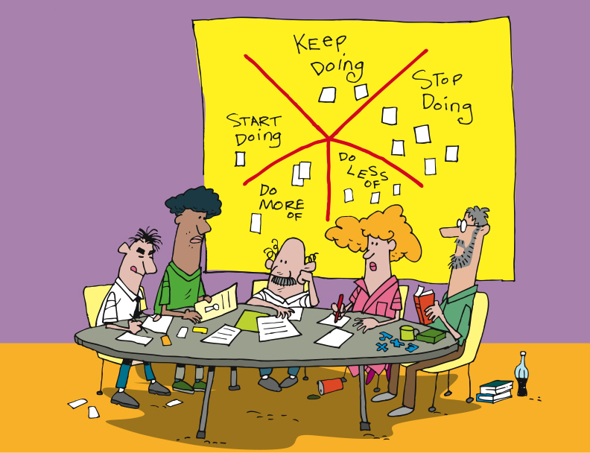
Retrospectives
“Whether you are using Agile methods or more traditional incremental or iterative development, your team has an opportunity to reflect at the end of every increment and identify changes and improvements that will increase the quality of the product and the work life of team members.”
Esther Derby and Diana Larsen
“…a well-run retrospective can help members of a community understand the need for improvement, and motivate them to change how they go about their work.”
Norm Kerth
http://www.thekua.com/rant/wp-content/uploads/2006/03/StarTechnique.gif
Notes:
Rodin, the artist, said
“Nothing is a waste of time if you use the experience wisely.”
Oscar Wilde said
“Experience is the name everyone gives to his mistakes.”
[CLICK]
Norm Kerth – 2000 – ‘Project Retrospective’ [CLICK]
Esther Derby and Diana Larsen – 2006 - wrote the book “Agile Retrospectives: Making Good Teams Great”.
[CLICK]
At the end of each Iteration, Release
Starfish model – Patrick Kua – TW
Review the model
Action items
Reduce waste, constant improvements
What’s the purpose of having a retrospective? It should be:
Informative – Communicate “the story” to all
Enlightening – Capture data, metrics or collective wisdom gained from the project
Progressive – Improve process/management/culture
Cathartic – Repair damage to the team or allow the team to enjoy what’s been accomplished
-----------------------------------------------------------------------------------------------------------
Rodin, the artist, said “Nothing is a waste of time if you use the experience wisely.”
Oscar Wilde said “Experience is the name everyone gives to his mistakes.”
And Kierkegaard said “Life can only be understood backward, but it must be lived forward.”
In 2001, Norm Kerth wrote the book “Project Retrospectives,” in which he said [CLICK] “a well-run retrospective can help members of a community understand the need for improvement, and motivate them to change how they go about their work.”
Following in Kerth’s footsteps, in 2006 Esther Derby and Diana Larsen wrote the book “Agile Retrospectives: Making Good Teams Great”. In their book, Esther and Diana said [CLICK] “Whether you are using Agile methods or more traditional incremental or iterative development, your team has an opportunity to reflect at the end of every increment and identify changes and improvements that will increase the quality of the product and the work life of team members.”
[CLICK] Agile teams generally include retrospectives as one of their practices. While different teams make different choices, it’s most common for teams to do retrospectives at each milestone – that is, at the end of each Iteration, Release, and at the end of the Project. We recommend Derby and Larsen’s book “Agile Retrospectives” as a key component of your team’s library. The activities and guidance in this book are priceless.
The goals of retrospectives, as stated by Kerth and Derby and Larsen, are to use the past – our experience – to improve our future. Whether it’s team functioning and communication – focused on the people – or technology, architecture, and technical practices, the goals are the same – learn and improve.

Slide 7
Maintaining Visibility and Communications
Notes:
Accurate visibility into project progress has traditionally been a problem
Agile address this by making project status extremely visible to everyone
----------------------------------------------------------------------------------------------------------------
One of the exciting and powerful aspects of Agile is the free flow of information and communication. This is true both within an Agile team, and between the team and the rest of the organization. Agile teams talk about transparency, meaning that facts and information are freely available at all times, and that our successes and failures are equally visible.

Slide 8
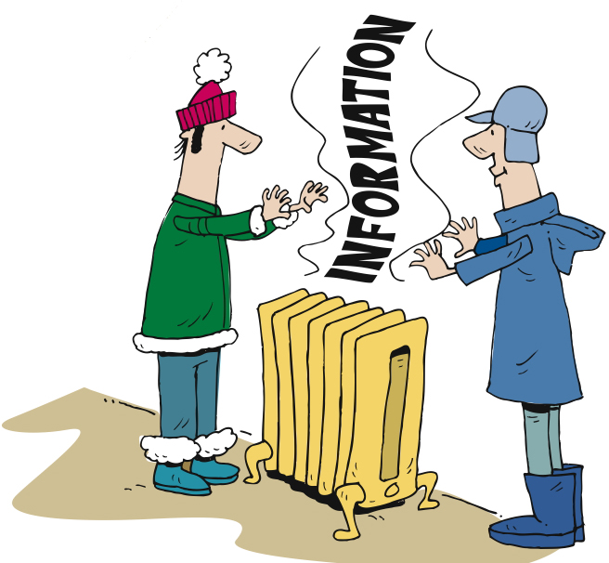
Information Radiators
Notes:
Static sources of information available to anyone who chooses to view them.
No request needed
Always updated and ready to view [CLICK]
Standard ones [CLICK]
Custom ones
----------------------------------------------------------------------------------------------------
One of the tools for this communication and transparency is a category of things that we refer to as “information radiators”.
[CLICK]
Information radiators are static sources of information that are available to anyone who chooses to view them. By “static” we mean that there is no request needed and no specific interaction (although we’ll get back to this when we talk about Mingle). Rather, information radiators provide information simply by viewing them. Examples [CLICK] are the card wall and the burn-up chart which we touched on briefly a bit earlier in this module. The card wall is always there, and anyone can look at it and learn the state of the project, release, or iteration.

Slide 9
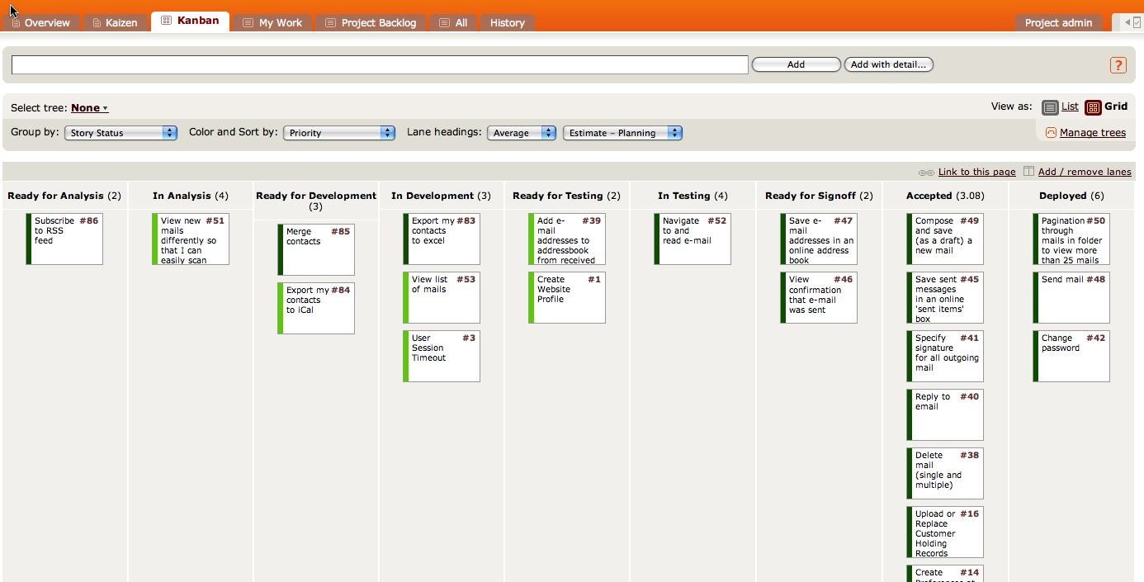
The Card Wall
Notes:
Card wall is in the team room
Easily accessible and visible
Mingle example [CLICK]
Not methodology dependent – scrum, lean, xp
Single iteration
Showing state of the card [CLICK] Ready for Analysis to Deployed
Some cards in next iteration – Analysts typically work iterations ahead of development
Clearly see the status of the iteration [CLICK] [CLICK]
--------------------------------------------------------------------------------------------------------
We’ve talked about the card wall throughout this course. Let’s look at it again, and an example of a card wall in Mingle.
[CLICK] It’s hard to overstate the value of the card wall. Regardless of the approach you follow – Scrum, XP, or Lean, for example – there is a card wall, and the value of it lies in its ability to communicate so clearly and completely, requiring little effort on the part of the reader.
Here’s an example of a representation of a card wall in Mingle. As you can see, this card wall is focused on a single Iteration, covering states [CLICK] from Ready for Analysis to Deployed. In many cases, the stories in the Ready for Analysis and In Analysis states are actually being prepared for the next Iteration. The work of Business Analysts is generally an Iteration ahead of the rest of the team, allowing them the time they need to figure out details and acceptance criteria so that the stories will be ready for the development team.
As you can see here, it’s easy to understand the state of the work being done in an Iteration on the card wall. For instance,[CLICK] we can see that there are a number of stories on which the work is complete that are waiting to be deployed. At the other end, [CLICK] there are a couple of stories that are ready for development, [CLICK] a few in development, and so on. Without even looking at the specific stories, [CLICK] we can learn a great deal about the project just by seeing the flow of work through viewing the card wall.

Slide 10
The Card Wall
Notes:
Card wall is in the team room
Easily accessible and visible
Mingle example [CLICK]
Not methodology dependent – scrum, lean, xp
Single iteration
Showing state of the card [CLICK] Ready for Analysis to Deployed
Some cards in next iteration – Analysts typically work iterations ahead of development
Clearly see the status of the iteration [CLICK] [CLICK]
--------------------------------------------------------------------------------------------------------
We’ve talked about the card wall throughout this course. Let’s look at it again, and an example of a card wall in Mingle.
[CLICK] It’s hard to overstate the value of the card wall. Regardless of the approach you follow – Scrum, XP, or Lean, for example – there is a card wall, and the value of it lies in its ability to communicate so clearly and completely, requiring little effort on the part of the reader.
Here’s an example of a representation of a card wall in Mingle. As you can see, this card wall is focused on a single Iteration, covering states [CLICK] from Ready for Analysis to Deployed. In many cases, the stories in the Ready for Analysis and In Analysis states are actually being prepared for the next Iteration. The work of Business Analysts is generally an Iteration ahead of the rest of the team, allowing them the time they need to figure out details and acceptance criteria so that the stories will be ready for the development team.
As you can see here, it’s easy to understand the state of the work being done in an Iteration on the card wall. For instance,[CLICK] we can see that there are a number of stories on which the work is complete that are waiting to be deployed. At the other end, [CLICK] there are a couple of stories that are ready for development, [CLICK] a few in development, and so on. Without even looking at the specific stories, [CLICK] we can learn a great deal about the project just by seeing the flow of work through viewing the card wall.

Slide 11
The Card Wall
Develop the outline of your card wall
Put the cards for iteration 1 onto the wall
Notes:
Prioritize stories into Minimum Marketable Features (MMF)

Slide 12
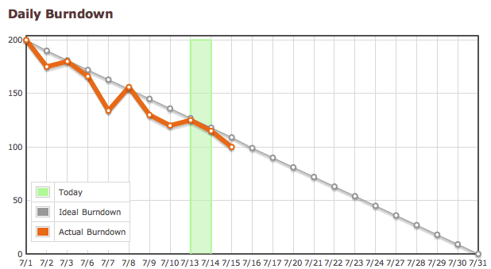
Reporting Progress – Burn Down
Notes:
2 primary radiators – Burn up and burn down
Comes directly from SCRUM
Same info in slightly different format
What we have to do [CLICK]
And when we are done [CLICK]
Release and/or iteration level charts
---------------------------------------------------------------------------------------------------
There are two primary reports that are used by Agile teams: the Burn Down chart, and the Burn Up Chart. The Burn Down chart comes directly from Scrum. Both charts represent the same information, fundamentally, but in a slightly different presentation.
The Burn Down chart approach is to start with the assumption that we know how much work we have to do [CLICK], and that we know we’re done when there’s nothing left to do [CLICK]. This is used for release level reporting, and is based on the practice of identifying all stories to be done during this release, and assuming that there will be no changes. While it is adaptable, and can accommodate changes in scope, it is not as clear, in our estimation, as…

Slide 13
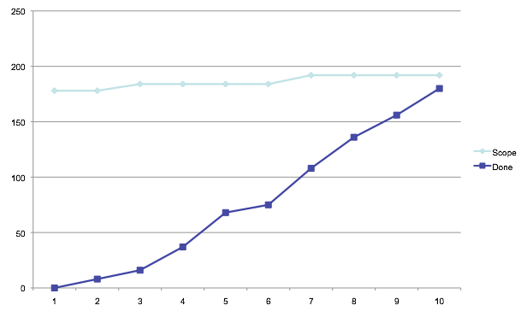
Reporting Progress – Burn-Up
Scope
Velocity
Notes:
Burn-Up Chart
Primarily discussion, with an example of a burn-up chart

Slide 14
Release Burnup
Develop an outline of a release burnup chart
What is the total number of points in your MMF?
How many iterations do you think you need?
Notes:
Prioritize stories into Minimum Marketable Features (MMF)

Slide 15
Questions?

